Slide 1
Foundation - Topic 1 – Logging On and What are Networks
Starter
Using the login details your teacher gives you, log in. Help others.
Make the following folders if you do not already have them:
Year 7, Year 8, Year 9
Inside Year 7 create a ‘Computing’ sub folder
Inside the ‘Computing’ folder make sub folders as follows:
Introduction
Small Basic
Spreadsheets
Theory

Slide 2
Logging On To The network
Username – 21SmithJ@croftonschool.co.uk
Password – Crofton1 or Student21 (Choose something that you can remember (write it here “ “)
Password
Number
Uppercase letter
Lowercase letter
Symbol
Minimum 6 digits
How to save to your network area.
Read the Computing agreement in your planner and sign

Slide 3
Foundation - Topic 1 – Logging On and What are Networks
Foundation:
Up to and including 3
Your teacher will tell you’re your target grade:
3. Go to the Pupil Work area
> Year 7
> Computing
>Introduction
>Foundation, Intermediate or Advanced
Copy all of the documents in this area and paste them in your Introduction folder.
If you do not have a target grade choose the Intermediate documents.
Complete the following 4 slides:
Intermediate:
4 to 5
Advanced:
6 and above

Slide 4
Mastery Statements Level 2 – 3
Mastery 2 (IT)
2(1) I can create and organise my folders with a little help.
2(3) I can use text and images to produce a leaflet.
2(5) I can receive feedback (what went well).
2(5) I can receive feedback (even better if).
2(5) I can make improvements to my work.
Mastery 3 (IT)
3(1) I can organise my folders to with capital first letters for document folders/names.
3(2) I can use text, images and other software to produce my leaflet.
3(3) I will write what I improved on my leaflet.

Slide 5

Foundation - Produce a leaflet on the Network at Crofton School
Use the information in slides 6-8 to start a leaflet on the Network at Crofton School
Star Network
Notes
Network
Notes
Printing
Notes
To print at our school
A star network is ..
A network is
Notes:
You can choose a program of your choice or use the SmartArt here.
Write full sentences on the information.
You could add images.
Gain 1 x www (what went well – put this on your leaflet)
Gain 2 x ebi (even better if – put this on your leaflet)
Act on the feedback ((3)write what you did following the feedback)

Slide 6
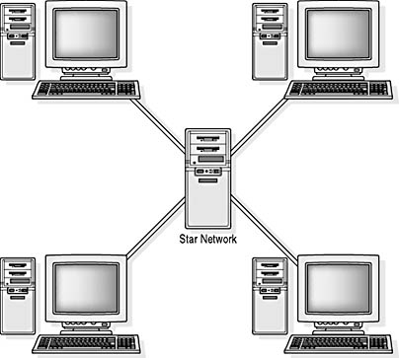
What Is A Network?
We use a star network

Slide 7
What is A Network?
All of the computers are connected to a central SERVER
Each computer is called a CLIENT
You save to the server, not the Client
This means you can get your work from any computer in the school
Printers are also connected to the server

Slide 8
Printing
Virtual queue
Own password for copying
Allowance £1.50
3p B&W and 15p colour

Slide 9
How have I done?
 | Self Ass Y/N
A
B
C
D
E
Mastery 2
2(1) I have created and organised my folders with a little help.
2(3) I have used text, images to produce a leaflet.
2(5) I got 1 x www.
2(5) I got 2 x ebi’s.
2(5) I made improvements to my work.
 | Self Ass Y/N
A
B
C
Mastery 3
3(1) My folders are organised and have a capital first letter for document folders/names.
3(2) I have used text, images and other software to produce my leaflet.
3(3) I wrote what I improved on my leaflet.

